Slide 1
RELATIONAL DATABASE ENGINEERING
Instagram clone DB Case Study: Advanced SQL Analytics & Growth Insights
Solving key business challenges using MySQL: user retention, campaign scheduling, bot detection, and hashtag performance.
MySQL 8.0
7 Core Data Tables
Production-Ready Analytics

Slide 2
DATA MODEL
Instagram Relational Schema Architecture
Users & Follows
Photos & Likes
Comments & Tags
Self-referential junction table mapping multi-user follower/followee relationships.
One-to-many user photos paired with composite primary key likes table.
Threaded user comment logs and many-to-many photo tag categorization.

Slide 3
MARKETING STRATEGY
Optimal Days for Ad Campaign Scheduling
Thursday
16 Registrations
Peak Days Identified
Thursday and Sunday lead platform acquisition. Launching ad campaigns on these days maximizes conversion rates.
Sunday
16 Registrations
Friday
15 Registrations
Tuesday
14 Registrations
SELECT DAYNAME(created_at), COUNT(*) FROM users GROUP BY 1 ORDER BY 2 DESC;

Slide 4
USER RETENTION
Targeting Inactive Users for Re-engagement
LEFT JOIN Filtering
26%
Isolated non-active users by querying across user records.
photos.id IS NULL
Zero-Post Accounts
Users registered who have never uploaded a photo to the platform.
Automated Email Campaigns
Triggers personalized re-engagement emails with onboarding prompts and trending tags.

Slide 5

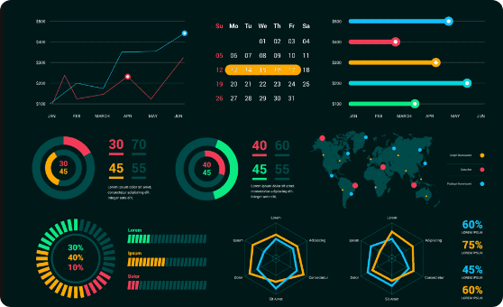
CONTEST ANALYTICS
Contest Winner: Most Liked Photo
Winning Creator
@Zack_Kemmer93
48
#145
Total Likes
Photo ID
High engagement concentration driven by early platform activity and viral hashtag association.

Slide 6
PLATFORM METRICS
Overall User Engagement Statistics
2.57
74
257
Avg Posts / User
Active Content Creators
Total Photos Uploaded
Calculated across total platform photos vs total accounts
Users with at least one published photo
Total media content stored on system servers

Slide 7
BRAND COLLABORATION
Top 5 Most Commonly Used Hashtags
#smile
59 uses
#beach
42 uses
#party
39 uses
Brand Takeaways
Lifestyle and positivity hashtags dominant platform trends. Recommended for corporate sponsor placement.
#fun
38 uses
#concert
24 uses

Slide 8
PLATFORM INTEGRITY
Bot Detection: Identifying Automated Spam Accounts
HAVING Clause Filter
13 Accounts
Isolated bots using .
HAVING total_likes = (SELECT COUNT(*) FROM photos)
Liked 100% of All Photos
Anomalous behavior: total likes equal total photo count (257 likes per bot).
Security Impact
Removing these 13 accounts cleanses artificial engagement metrics and protects advertiser trust.

Slide 9
USER BEHAVIOR
User Archetype Breakdown: Active vs Lurker Accounts
ARCHETYPE A
ARCHETYPE B
Ghost Users
Engaged Commenters
23%
77%
Users who have never submitted a single comment on any platform photo.
Users actively commenting and engaging with community posts.

Slide 10
ACTIONABLE ROADMAP
Data-Driven Growth & Security Roadmap
Schedule Optimization
Bot Purge Workflow
Nudge Campaigns
Concentrate paid acquisition campaigns on Thursdays and Sundays.
Automate SQL triggers to flag users with 100% like rates.
Deploy email prompts to 26% of accounts with zero photo posts.

Slide 11

SQL Analytics Completed
Leveraging database architecture and analytical queries to drive product growth, platform security, and business intelligence.
Connect on LinkedIn for More SQL & Data Engineering Case Studies

